Slide 1

Department of E&TC
Bhujbal Knowledge City
Institute of Engineering
Project Review -2
Title : Theft Detection System Using Raspberry Pi
by Group id:
Group Members Name : Patil Sopan Suresh
Wani Juned
Adav Karan
Guide: Prof. Pankaj Patil
Department of Electronics & Telecommunication

Slide 2
Bhujbal Knowledge City
Institute of Engineering
Presentation outlines :
1. Detailed block diagram
2. Detailed circuit diagram.
3. Component details.
4. Applications.

Slide 3
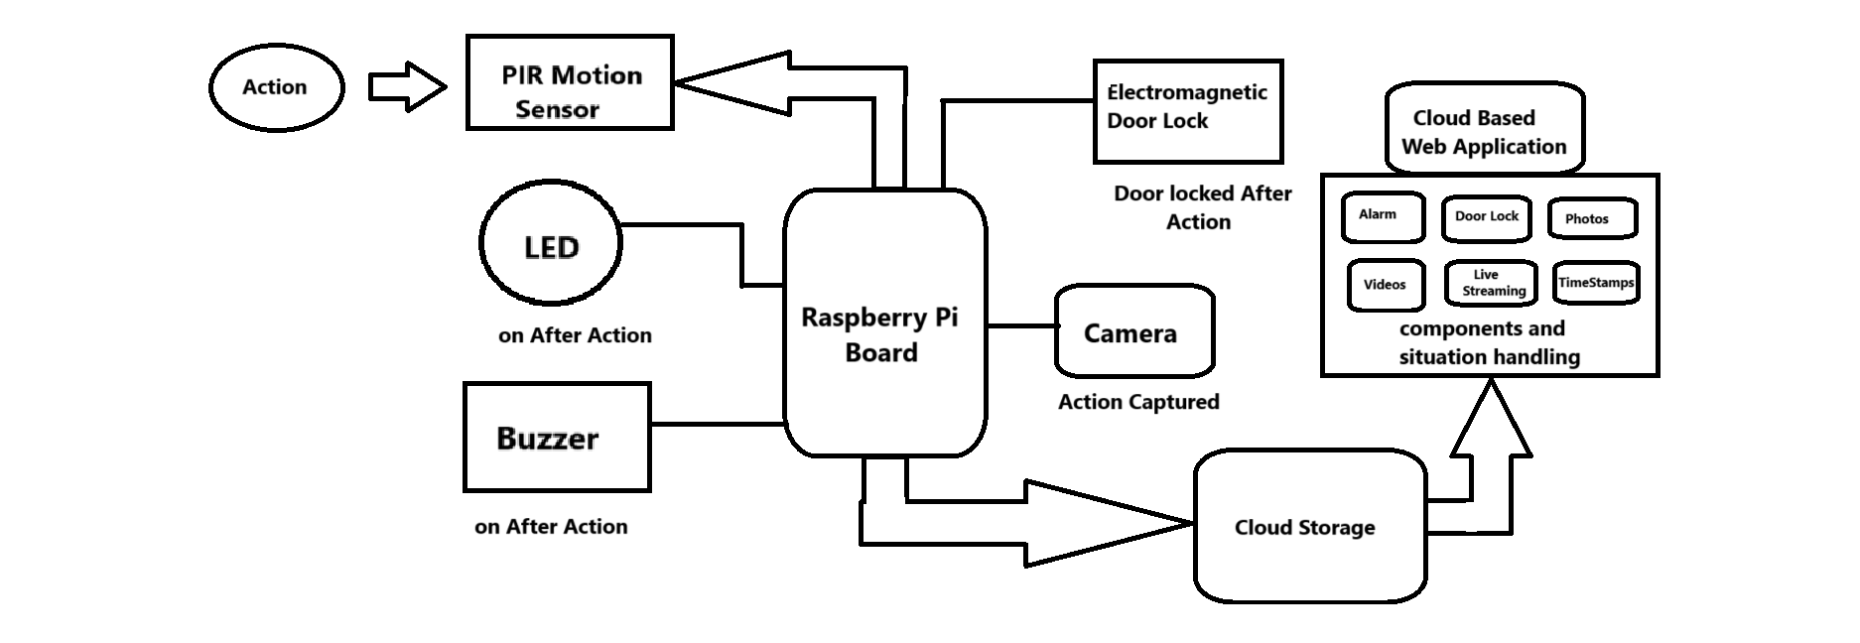
Bhujbal Knowledge City
Institute of Engineering
Block Diagram

Slide 4
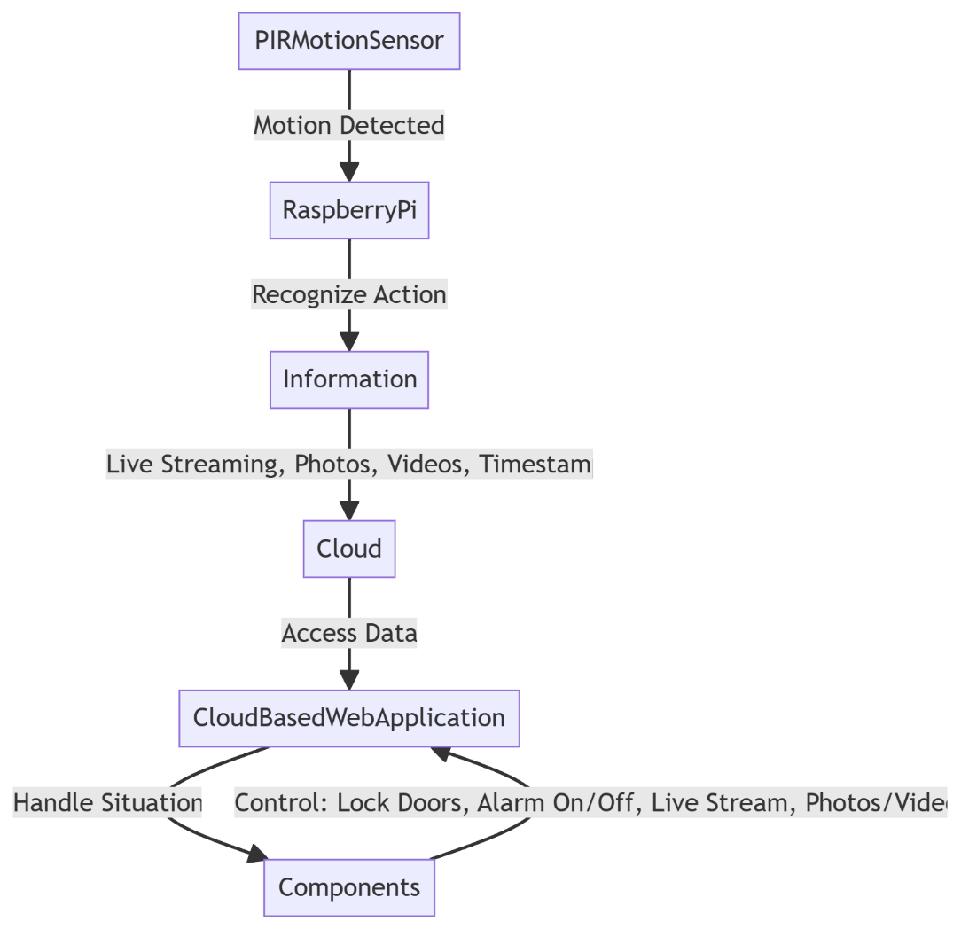
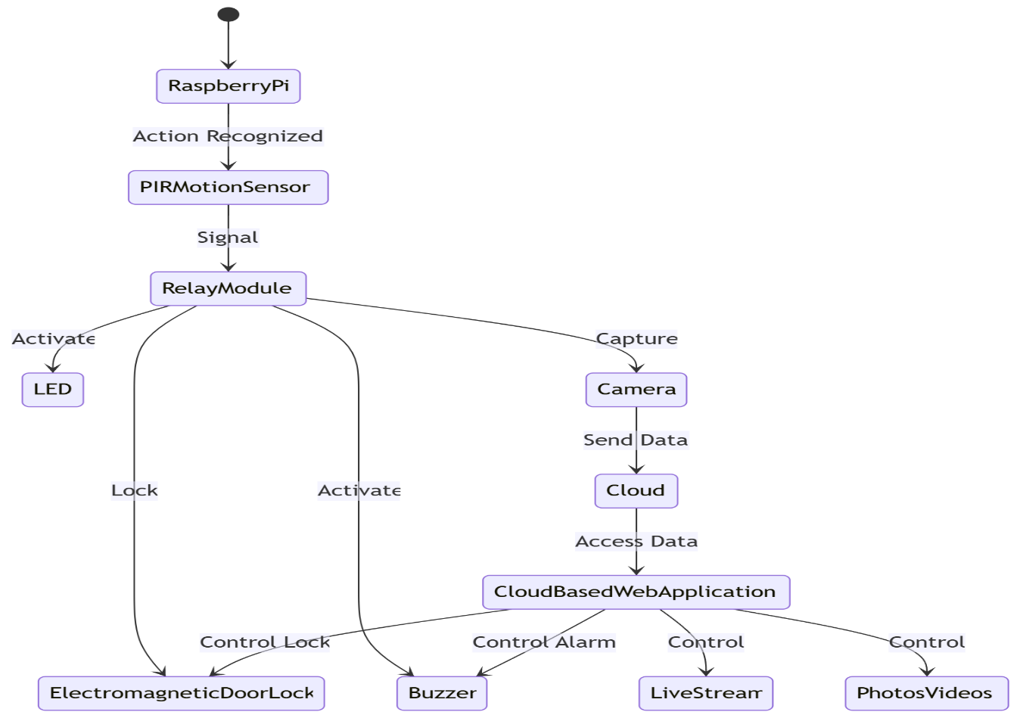
Bhujbal Knowledge City
Institute of Engineering
Flow Chart and State Diagram

Slide 5
Bhujbal Knowledge City
Institute of Engineering
Circuit Diagram

Slide 6
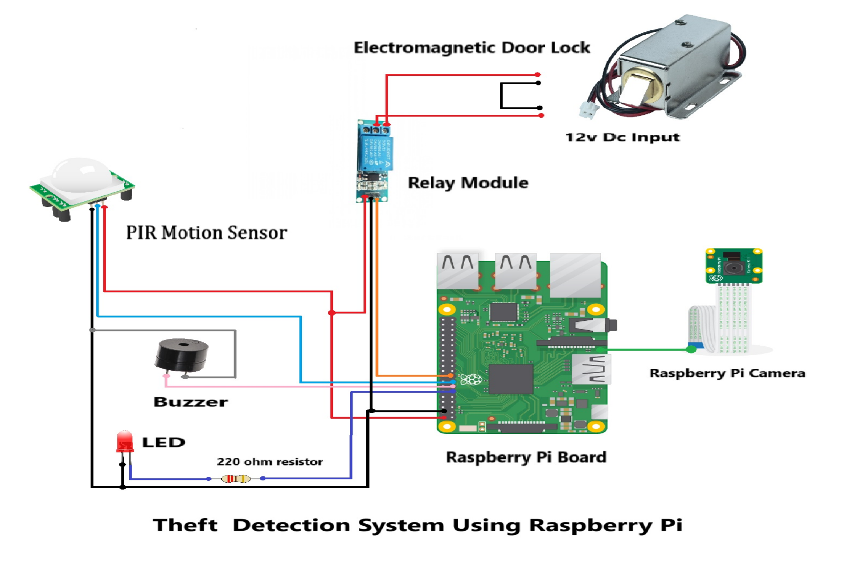
Bhujbal Knowledge City
Institute of Engineering
Circuit Diagram

Slide 7
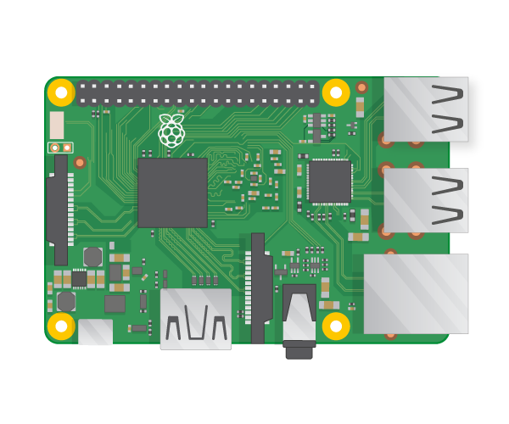
Bhujbal Knowledge City
Institute of Engineering
Component details
1.Raspberry Pi :
The Raspberry Pi is a small, affordable computer used for programming, education, and DIY projects. It features an ARM processor, up to 8GB RAM, GPIO pins for hardware connections, and supports operating systems like Raspberry Pi OS. It's popular for learning, IoT, and hobbyist electronics projects due to its versatility and low cost.
Key Features:
ARM-based CPU: Powerful Broadcom processor.
RAM: Options of 1GB, 2GB, 4GB, or 8GB LPDDR4.
Storage: Uses microSD card for OS and file storage.
USB Ports: 2x USB 3.0 and 2x USB 2.0 for peripherals.
HDMI: Dual micro-HDMI with 4K output support.
GPIO: 40 pins for hardware interfacing (sensors, motors).
Networking: Gigabit Ethernet, dual-band Wi-Fi, Bluetooth 5.0.
Power: 5V/3A via USB-C for stable operation.
Camera/Display Interfaces: CSI for camera, DSI for displays.
Audio: 3.5mm jack and HDMI for audio output.

Slide 8
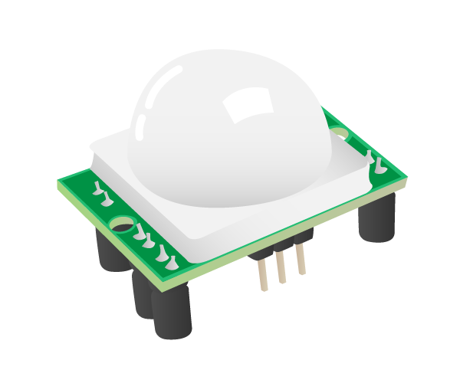
Bhujbal Knowledge City
Institute of Engineering
Component details
2. PIR Sensor: A PIR (Passive Infrared) sensor detects motion by sensing changes in infrared radiation in its environment, primarily emitted by warm bodies like humans or animals. It is commonly used in security systems, automatic lighting, and smart home devices.
Key Features:
Motion Detection: Senses movement based on infrared radiation changes.
Passive Operation: Does not emit any signals; it only detects infrared energy.
Wide Field of View: Typically covers about 110 degrees horizontally and 70 degrees vertically, with a range of 5 to 12 meters.
Low Power Consumption: Energy-efficient, making it suitable for battery-operated applications.
Cost-Effective: Affordable and widely available for various applications.

Slide 9
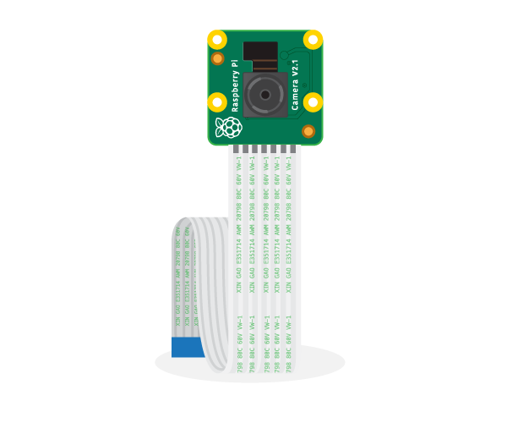
Bhujbal Knowledge City
Institute of Engineering
Component details
3. Raspberry Pi Camera :
The Raspberry Pi Camera is a small camera module designed for use with Raspberry Pi boards. It allows users to capture high-quality images and videos, making it ideal for projects involving photography, video streaming, and surveillance.
Key Features:
Image Quality: Available in various resolutions, with the latest models offering up to 12 MP.
Video Recording: Supports video recording at 1080p (Full HD) at 30 frames per second.
CSI Interface: Connects directly to the Raspberry Pi via the Camera Serial Interface (CSI) for high-speed data transfer.
Wide Compatibility: Works with various Raspberry Pi models and compatible software libraries like Raspberry Pi OS.
Low Light Performance: Some models come with infrared sensitivity, allowing for night vision capabilities with appropriate lighting.

Slide 10
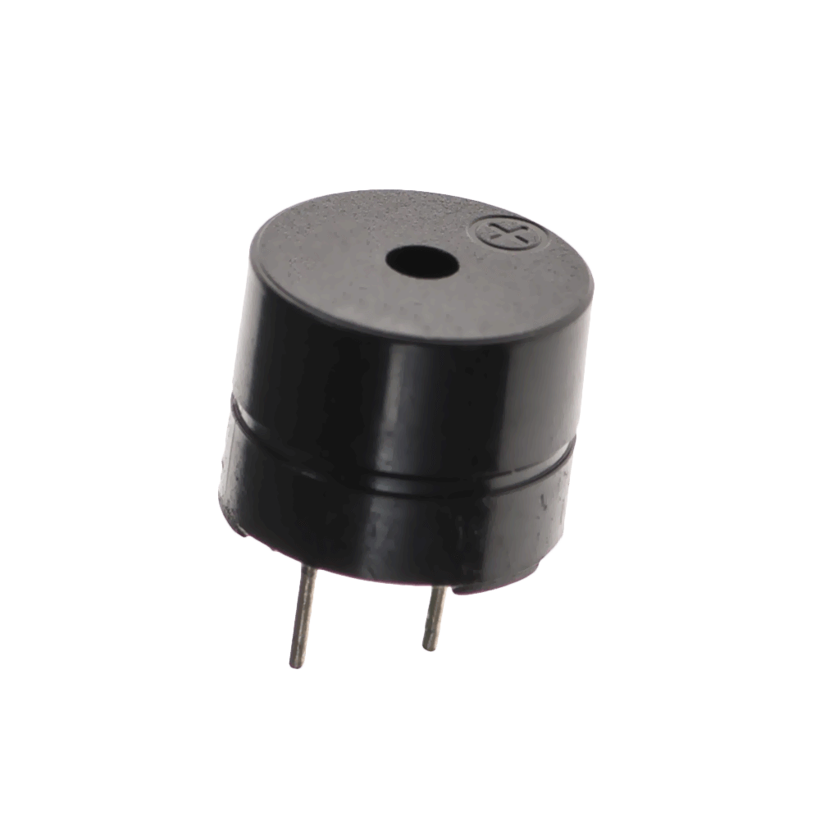
Bhujbal Knowledge City
Institute of Engineering
Component details
4. Buzzer :
A buzzer is an electronic device that produces sound, often used as an alert or notification in various applications. It converts electrical energy into sound energy, generating a tone or beep.
Key Features:
Types:
Active Buzzers: Produce sound when powered, containing built-in oscillators.Passive
Buzzers: Require an external signal to produce sound and can generate various tones based on the input frequency.
Sound Production:Commonly used to emit beeps, alarms, or tones in response to certain events or conditions.
Voltage:Operates typically at 5V to 12V, depending on the model.
Applications:Used in home appliances, alarm systems, toys, and embedded systems for alerts and notifications.

Slide 11
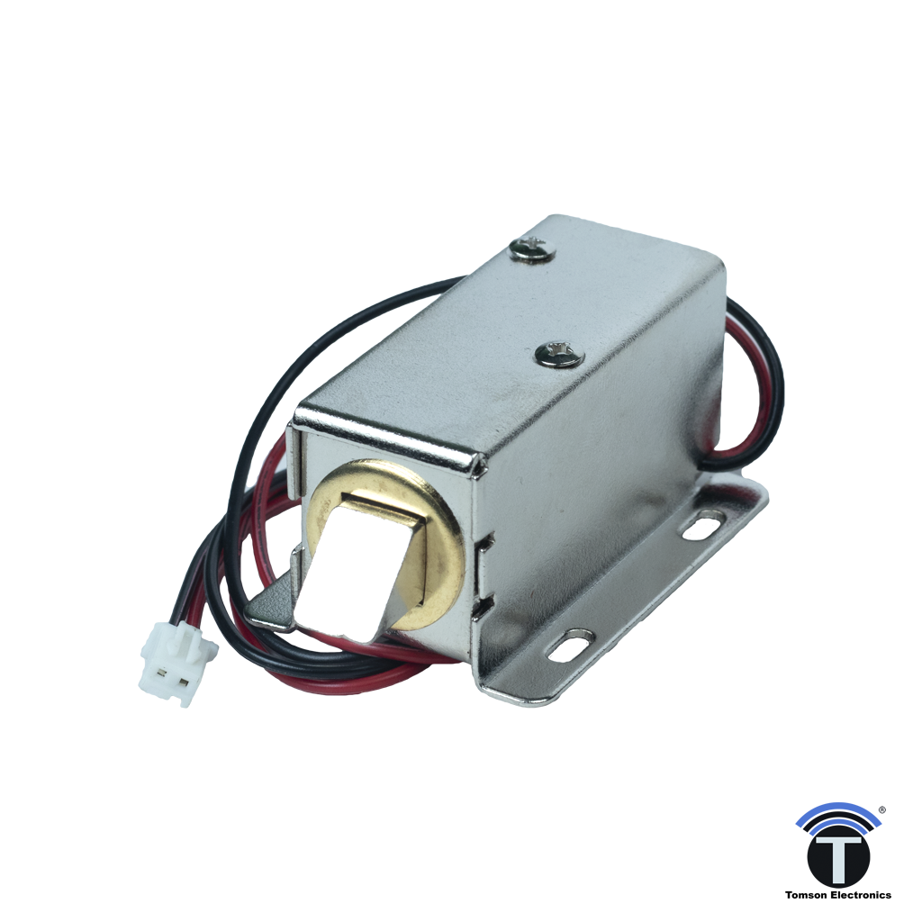
Bhujbal Knowledge City
Institute of Engineering
Component details
5. Electromagnetic Door Lock:
An electromagnetic door lock is a locking mechanism that uses electromagnetic force to secure doors. It typically consists of an electromagnet mounted on the door frame and a metal plate attached to the door.
Key Features:
Operation: Locks when powered, unlocks when power is cut.
Fail-Safe: Unlocks during power outages for safety.
Power: Requires 12V or 24V DC.
Durable: Strong and weather-resistant.
High Security: Difficult to bypass without proper power control.

Slide 12
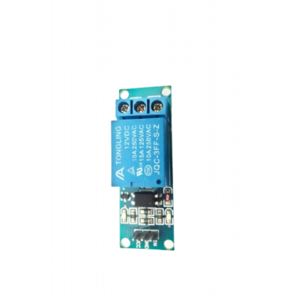
Bhujbal Knowledge City
Institute of Engineering
Component details
6. Relay Module :
A relay module is an electrically operated switch used to control high-power devices like motors, lights, or appliances using low-power signals from microcontrollers
Key Features:
Switching: Controls high-voltage devices with low-voltage signals.
Isolation: Electrically isolates control and power circuits for safety.
Multiple Channels: Available in single, dual, or multi-channel versions.
Common Uses: Used in home automation, industrial control, and embedded systems.
Trigger Voltage: Typically operates at 5V, 3.3V, or 12V.

Slide 13

Bhujbal Knowledge City
Institute of Engineering
Component details
7. LED:
An LED (Light Emitting Diode) is a semiconductor device that emits light when an electric current passes through it. LEDs are widely used for lighting, displays, and indicators due to their energy efficiency and long lifespan.
Features:
Energy Efficient: Uses less power than traditional bulbs.
Long Lifespan: Lasts much longer than incandescent lights.
Variety of Colors: Available in multiple colors and brightness levels.
Instant On: Lights up immediately when powered.
Applications: Used in displays, indicators, and lighting systems.

Slide 14
Bhujbal Knowledge City
Institute of Engineering
Applications
A theft detection system using Raspberry Pi can be applied in various settings to enhance security and automation.
Here are some common applications:
Home Security: Monitor entrances and detect unauthorized entry using PIR sensors and cameras, triggering alarms or notifications.
Retail Stores:Use motion sensors and cameras to detect suspicious movements and alert store personnel, preventing shoplifting.
Vehicle Security: Install in cars or motorcycles to detect motion or unauthorized access, alerting the owner via a mobile app or SMS.
Warehouses: Protect large storage areas by integrating with CCTV cameras and motion sensors to detect intrusions and record evidence.

Slide 15
Bhujbal Knowledge City
Institute of Engineering
Applications
5. Banks & ATMs: Use in ATMs to monitor for tampering or suspicious behavior, sending real-time alerts to security personnel.
6. Smart Cities:Integrated into smart infrastructure for public surveillance, ensuring safety in public spaces by detecting unusual activities.
7. Schools & Campuses:Enhance security by monitoring restricted areas and sending alerts to administrators in case of unauthorized entry.

